Slide 1
Settling the Northern Colonies
Chapter Three
The American Pageant

Slide 2
Defining Regions
New England Colonies
Middle Colonies
Chesapeake Colonies
Lower Colonies

Slide 3
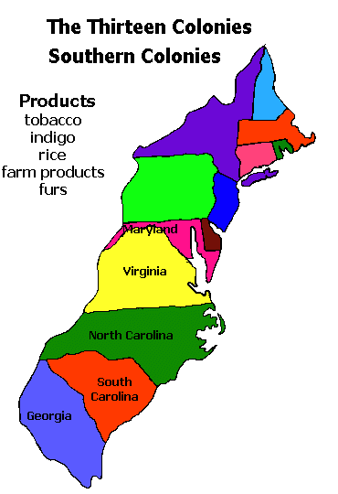
Life in Colonies—shaped by Geography
Religion shapes the Northern (NE) colonies
Protestant Reformation (1577)
Calvinism
From Calvin—Presbyterians, Puritans, Huguenots, etc.
Puritanism and the “elect”
Purify the Church of England from Catholicism
Typically poorer – reassured by Calvinism
Visible Saints = membership
Church of England enrolls all—separatists form
Life shaped by and built on religion
Life and economy shaped by geography / agriculture—still to this day!

Slide 4
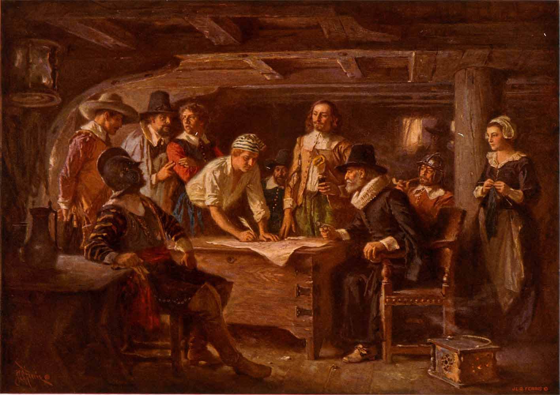
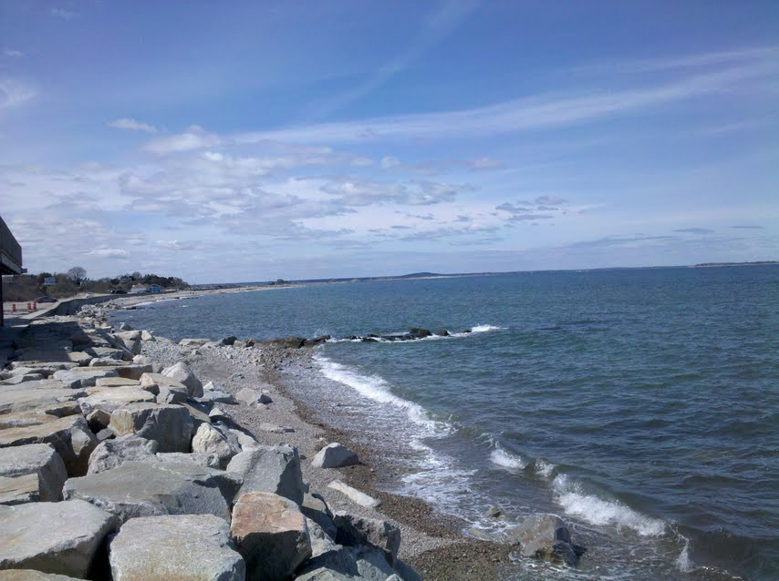
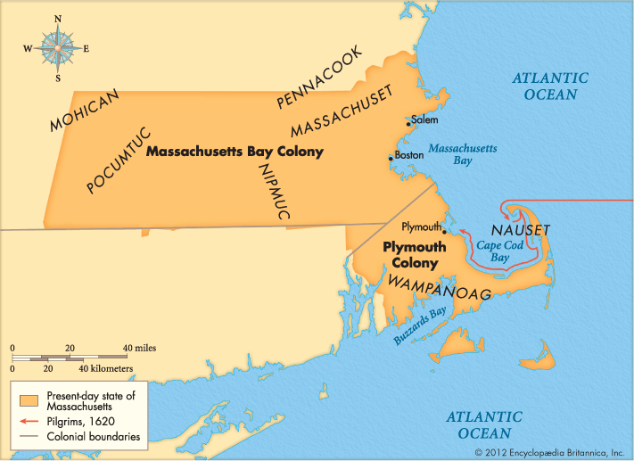
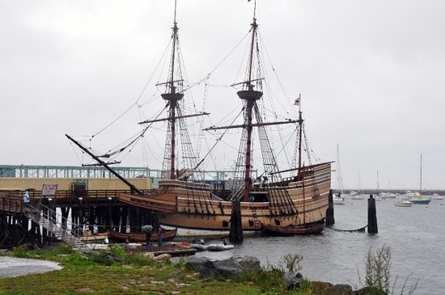
Plymouth
Pilgrims
1608—Holland; “Dutchification”
Virginia Company
1620—Mayflower lands in Plymouth (misses target!)
102 passengers—less than half were separatists
MAYFLOWER COMPACT
NOT a constitution, BUT…
Forms a simply government
Majority rule
No legal grounds or permission to do this!

Slide 5
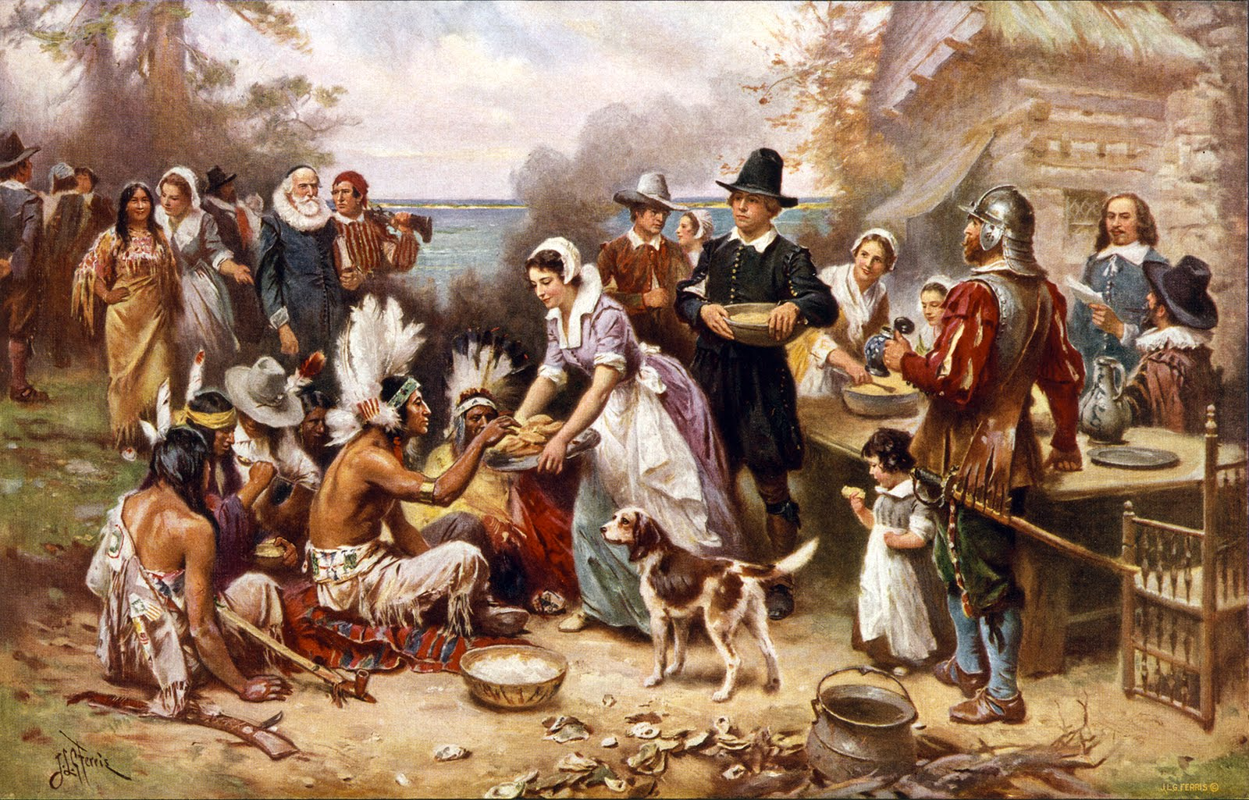
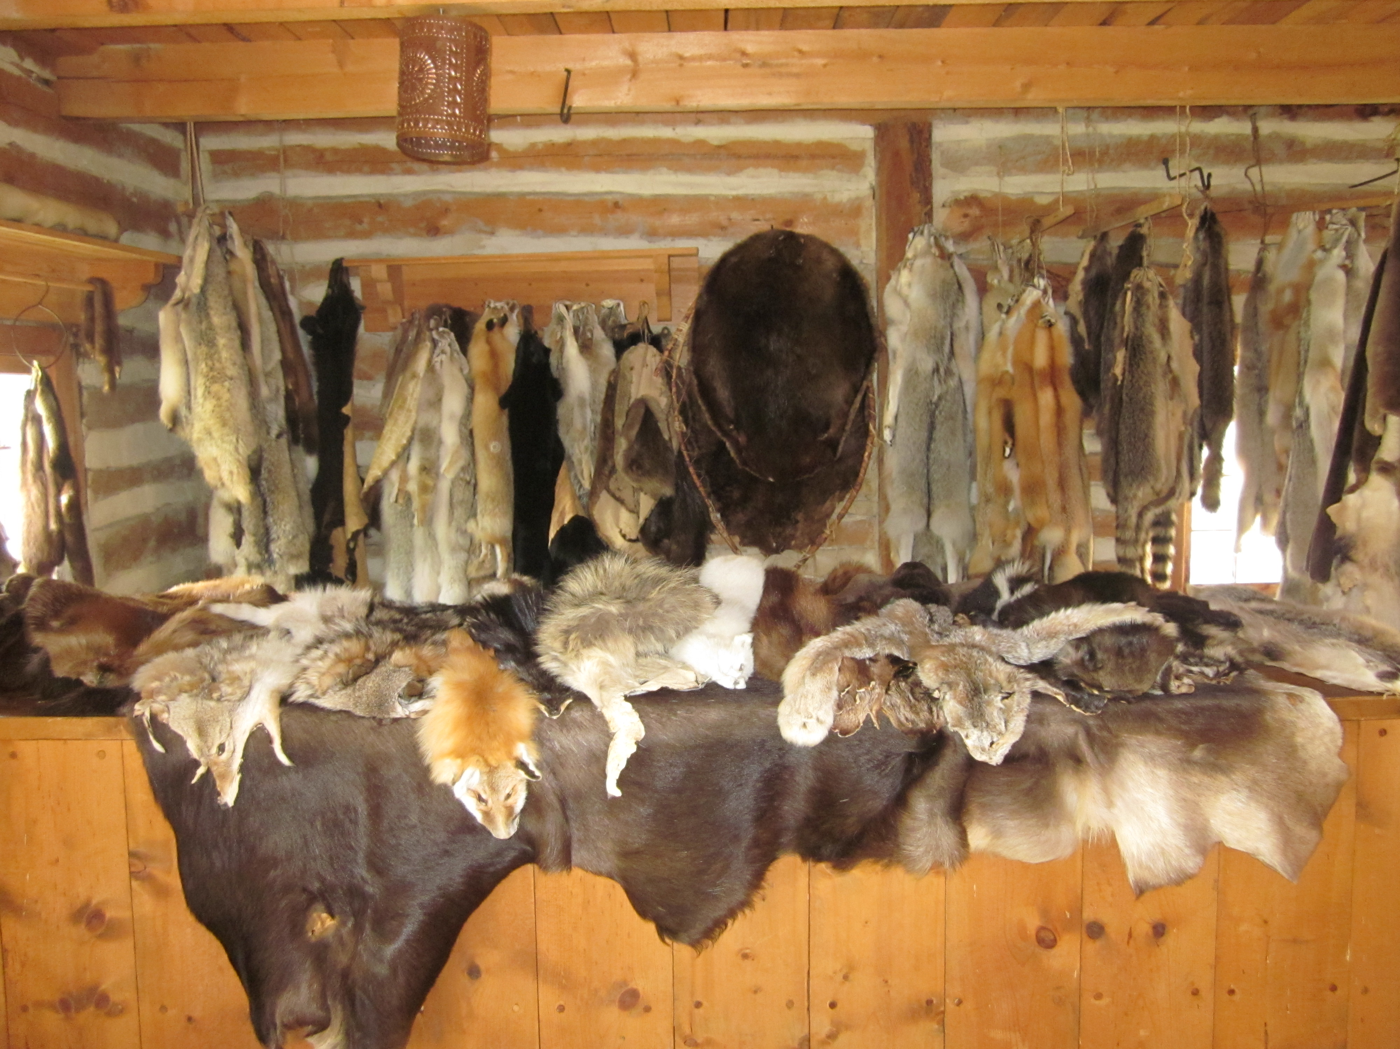
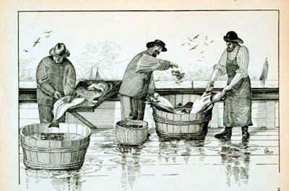
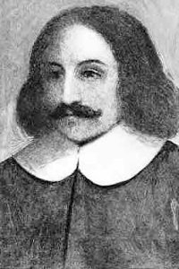
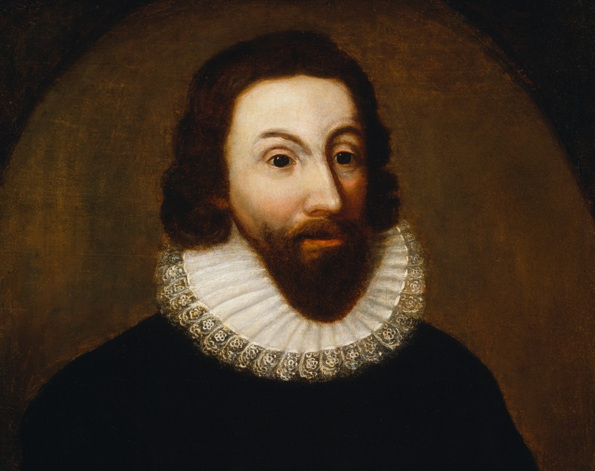
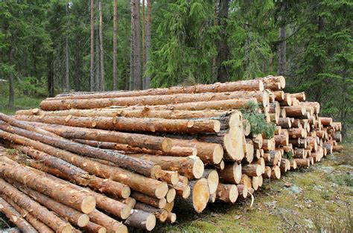
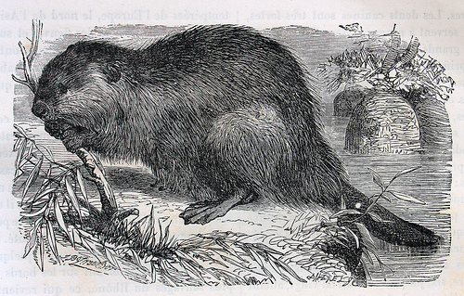
Life in Plymouth
Similar to Jamestown—very difficult
First winter: 44 / 102 settlers survive
None of them leave when Mayflower heads to England
Puritans—God blesses his children
Next fall—first Thanksgiving (harvest)
Colony grows!
William Bradford (elected 30 times); merges with MA
11,000 settlers!
First governor—John Winthrop (19 years)
Economy:
City on a Hill

Slide 6
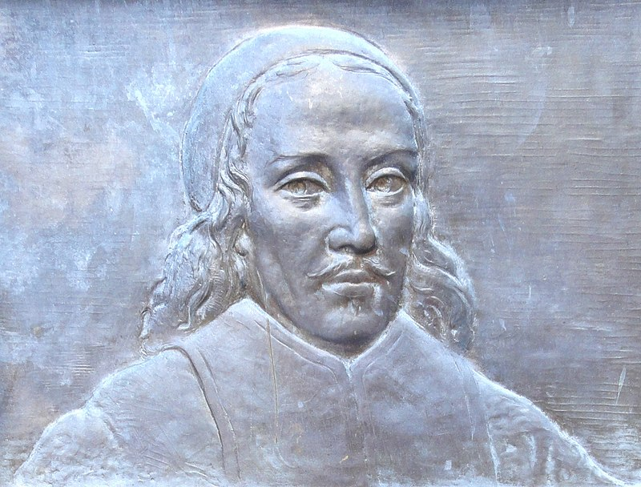
Building the Massachusetts Bay Colony
Open to “free men” | Must be a male in a Puritan Congregation & a visible saint!
No Church membership? | No Vote!
You’re a woman? | You can’t vote!
When the men vote… | Rule of the majority
Liberal for its time—still not a democracy! Can’t let everyone rule—people are too stupid!
Ultimate Purpose of Colony:
-Apply and enforce God’s law—it applies to all. Believers or otherwise!
-To do this, you must support the church. How? Taxes!
Want to place membership? –open investigation in to your life. No privacy.
John Cotton; Preached 6 hours / day; critic of Church of England

Slide 7
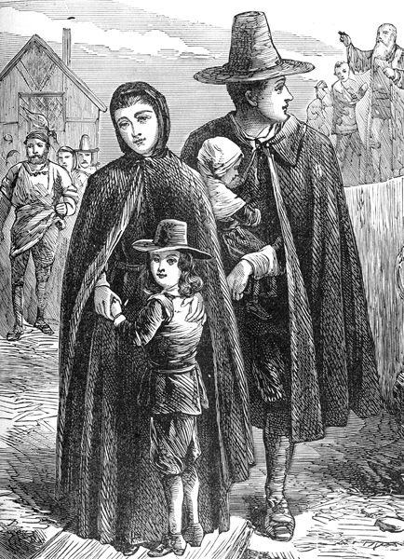
A Day in the Life of a Puritan
Church
Hires / fires ministers
Sets salary
Cannot hold political office
First hint of a separation between church and state
Daily Life
“Calling” is to do God’s work
Still eat, drink and sing, BUT…
PDA
Doomsday Poem

Slide 8
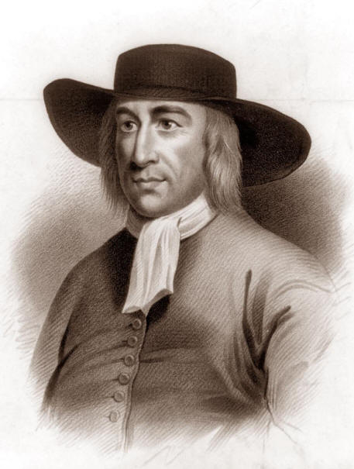
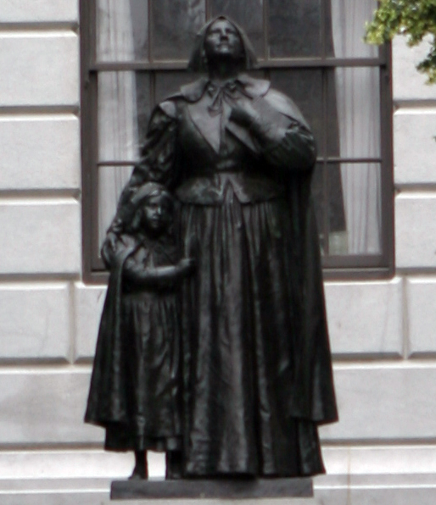
Dissent
Quakers
Fined, hanged, flogged for challenging authority of Puritans
Anne Hutchinson
14 kids. Talkative. Smart.
Holy life is no sign of salvation from God
Bible studies at home
Truly saved need not follow God’s law or man’s law
Antinomianism / high heresy
Put on trial—can’t catch her
“Revelation from God”
Banished…then killed

Slide 9
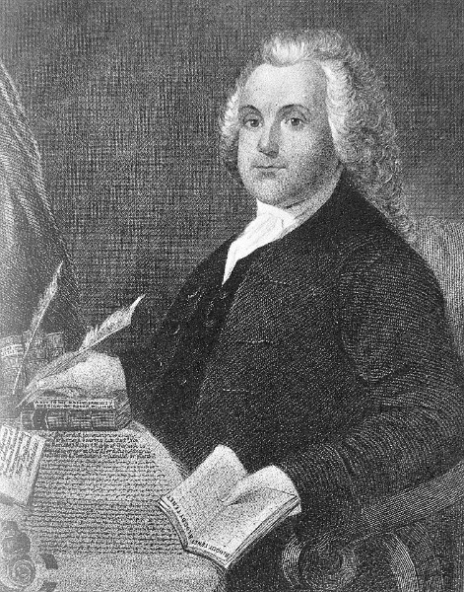
Roger Williams
No filter—calls for separation from Church of England
Shamed the charter of the Bay Colony
No legal, justified right to take land from Natives
Government should not regulate religious behavior
1635—banished for “dangerous ideas”

Slide 10
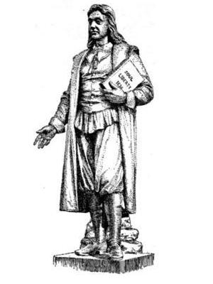
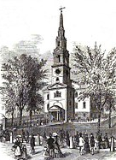
Rhode Island
“The Lord’s Sewer”
Williams flees to RI –Baptist Church
***NEED TO KNOW****
COMPLETE FREEDOM OF RELIGION—EVEN FOR CATHOLICS, QUAKERS AND JEWS
No oaths, no church attendance, no tax to support the church
Simple manhood suffrage

Slide 11
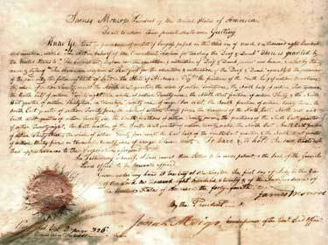
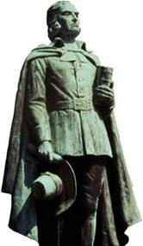
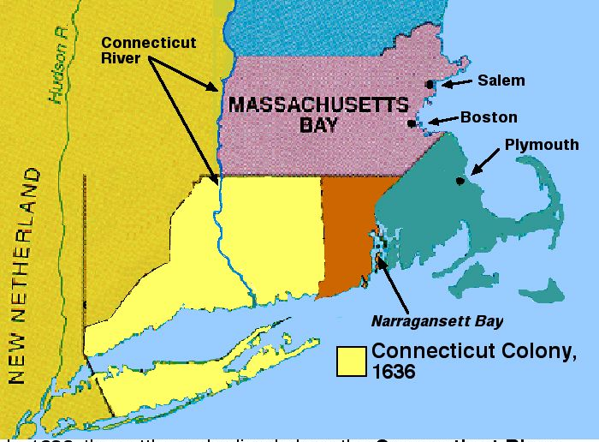
New England Grows
Dutch and English settling in NE
Forms Fundamental Orders of CT (1639) II A MODERN CONSTITUTION
Impact seen in its charter and its current state constitution!
Democratically controlled by substantial citizens (men)
1638: Squatter Puritan settlement in CT—falls through
Thomas Hooker
1662—Crown grants charter to CT Valley

Slide 12
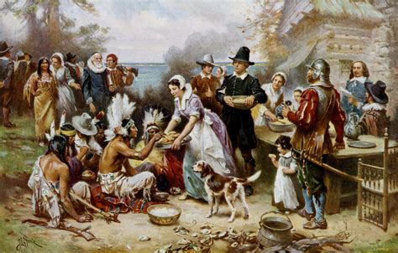
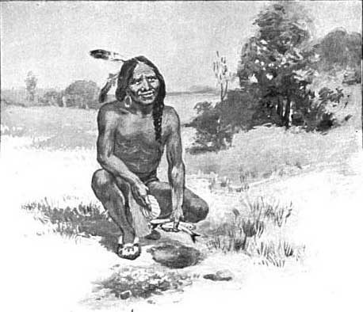
Pequot War
Puritans vs. Indians
At European contact—75% of Native Americans die in NE
Wampanoag Tribe
Befriends the settlers at first—cultural diffusion
Overseen by Squanto
Chief Massasoit signed peace treaty with Pilgrims (1621)
First Thanksgiving!

Slide 13
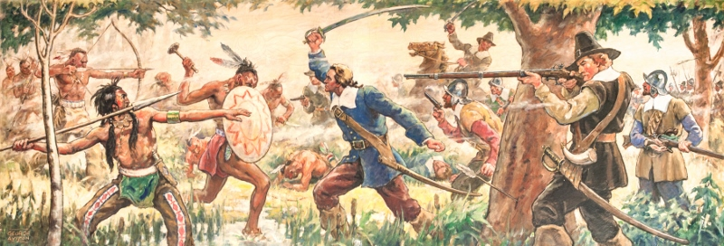
So…Why War?
More Europeans moved in—
more conflicts with Natives
Europeans form alliance with a separate tribe
Set fire to Pequot wigwams, villages
Those who fled were shot
Pequots decimated—four decades of tension
The justification?
GGG
1637—Must- Know Date!

Slide 14
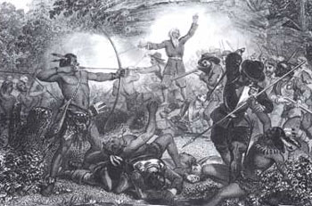
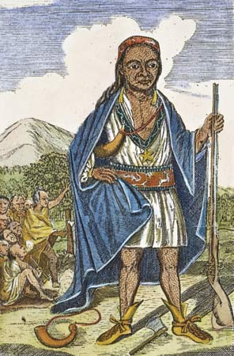
Native’s Response
Intertribal unity
1675 Metacom (Massasoit’s son)
King Philip (“Christianized” Name)
Launches attack on English—52 Puritan towns hit; 12 totally destroyed
Even so—the Natives lose!
Effect: England continues to move west
England faces less threats from Natives
Metacom’s son and wife sold in to slavery

Slide 15
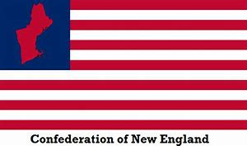
Seeds of Independence
1643: New England Confederation forms
Made up of Plymouth, Massachusetts, Connecticut, New Haven
Maine and Rhode Island blackballed
England at Civil War— “ignoring” colonies
Purely defensive coalition
Each colony gets two votes
MA doesn’t like
Representatives chosen by citizens
Similar In Kind, Different In Time to the
_________________________

Slide 16
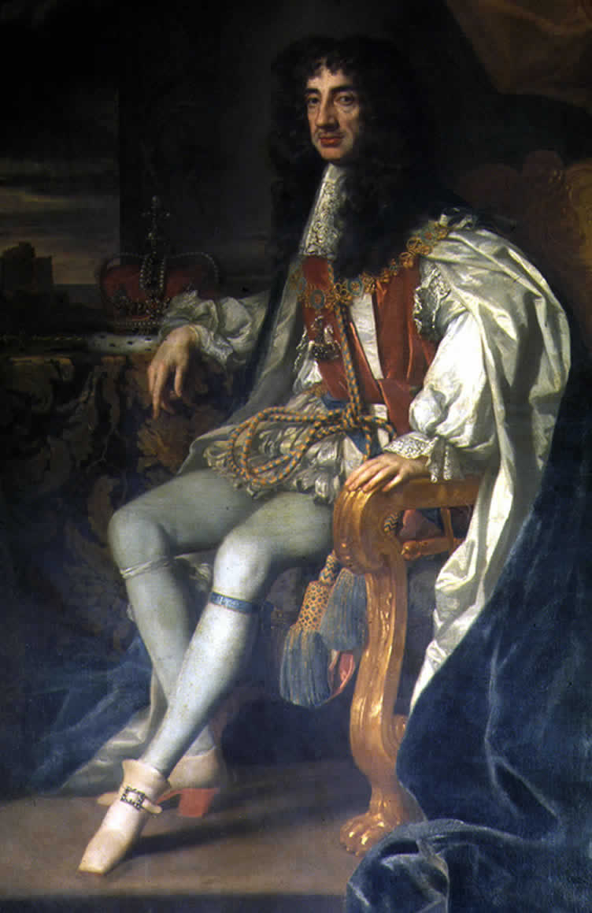
Backlash
Civil War in England—king pays little attention
UNTIL
1660—Charles back on the throne
Firm grip on Colonies
Colonies feel as though they’re already “free”
MA biggest dissenters
Need to be put in their place, SO:
CT granted legal squatter status; sea-to-sea charter
Rhode Island—new charter
MA—charter revoked

Slide 17
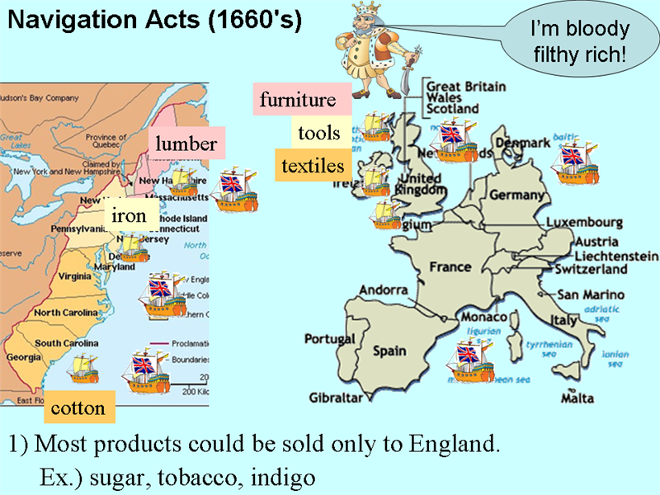
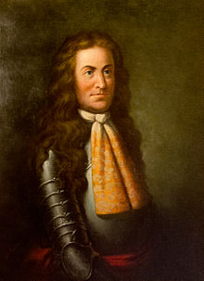
The First Revolution
1686
Dominion of New England established by Royals
Similar to NE Confederation; headquartered in London
Goal: Put colonies in place
Navigation Laws (1651)
America can only trade with countries tied to England
Smuggling goes up
Edmund Andros // English representative in Boston
No more town meetings; press; courts; schools, etc.
The people are furious—take a lesson from England: Glorious Revolution (1688)
William and Mary on the Throne // Dominion of NE collapses (bye, bye Andros)

Slide 18
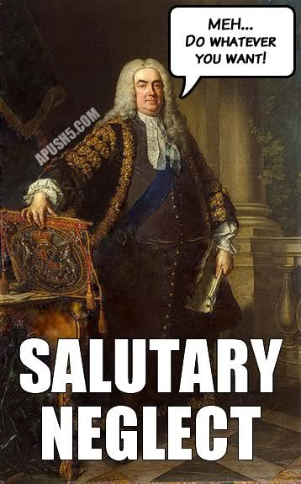
England’s Response
1691—New King, but…
MA is made a royal colony // Protestant Monarchy in England
Puritans crushed—voting rights extended to qualified males, not just the ‘elect’
Under new monarchy—**salutary neglect**
Decreases tensions in Colony
Loosening grip on Navigation Acts
In other ways—monarchy tightens grip
Place people in charge who are stupid; don’t know America

Slide 19
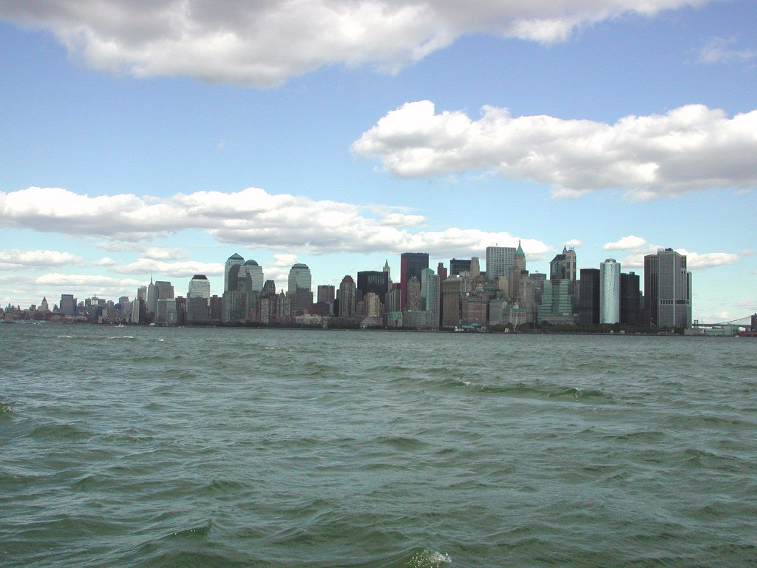
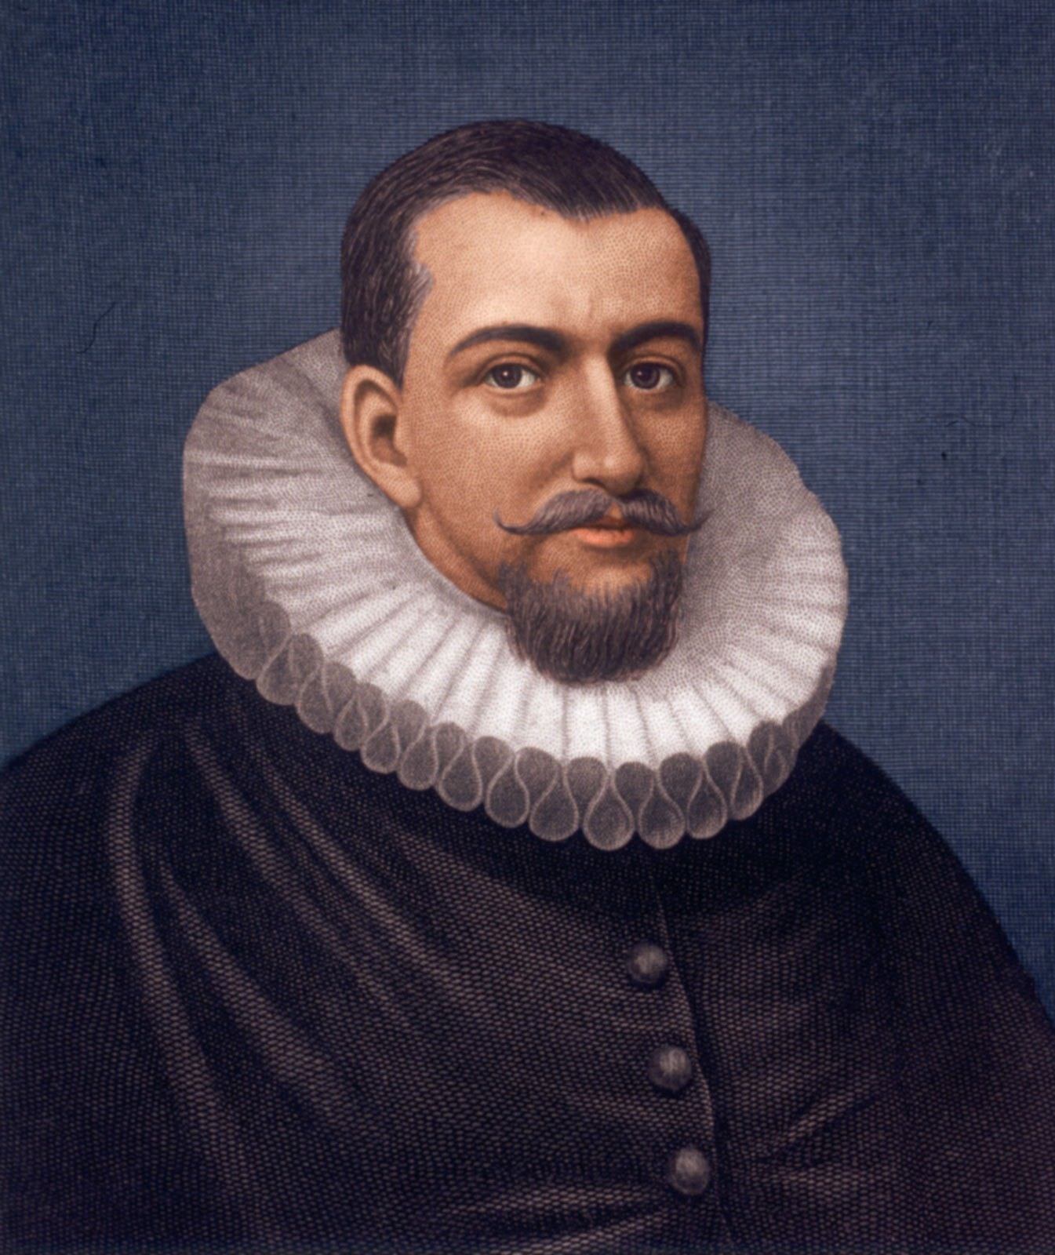
Old and New Netherlands
Dutch also exploring
Controlled by Spain; England helps them out
Repay England by fighting naval battles
Dutch East India Company
10k Men; 190 Ships
Look to Henry Hudson—Delaware Bay; NY Bay
Hudson River
New Netherlands—planted permanently 1623
New Amsterdam (NYC)—seaport; diverse
No religious toleration. No free speech. No democracy.
Governor appointed by government, not the people!
Relies on Fur trade
Purchases Manhattan from Natives

Slide 20
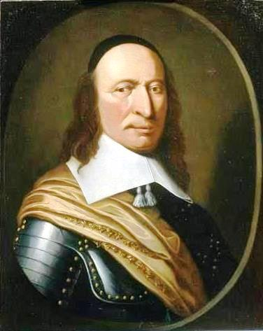
The Dutch
Dutch get off to a rocky start in NE
Director General—harsh, not savvy
Harsh to settlers and Natives alike
Builds a wall to protect the Dutch from invasion
Wall Street
Get too close to CT—ousts them!
Sweden tries to settle—also ousted
Still leaves impact on Delaware

Slide 21
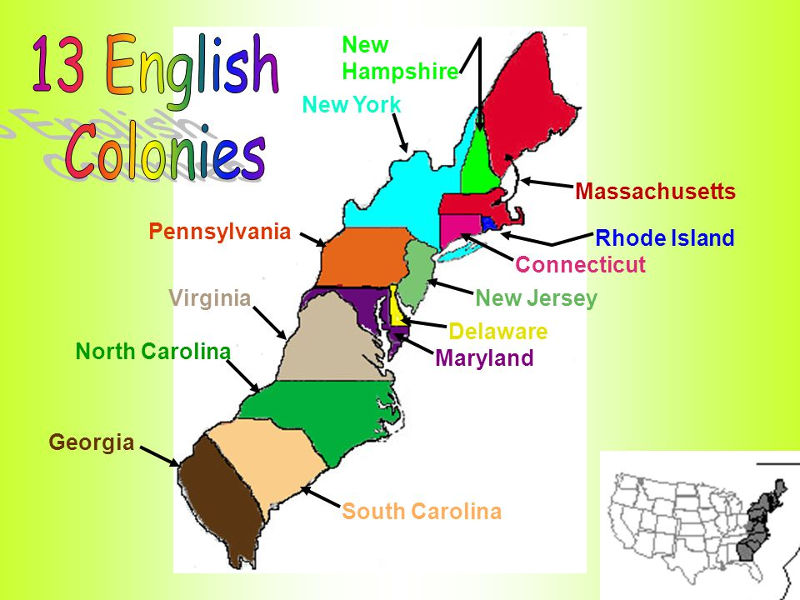
The Dutch, New York
England overpowers Sweden, Dutch
Take control of New Amsterdam
Led by Duke of York—New York
England now controls NY → SC (Georgia)
Land given to English “favorites” –slows growth!
Still see influence of the Dutch
Harlem, Brooklyn, Hellgate

Slide 22
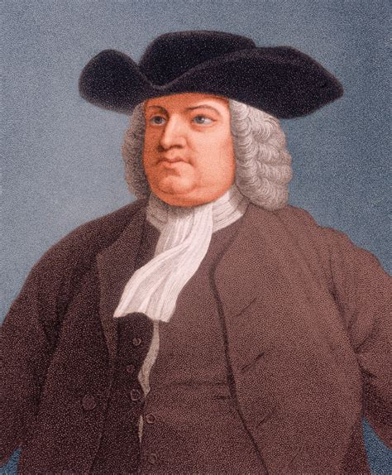
Pennsylvania
Quakers
Form in England; “Quake” when they hear the Message
Do not support a tax for church operations
Simplicity: house, dress, food; no $ for clergy
We are all children of God
No oaths; No military service; No war
Literally “turn the other cheek”
1681: Grant from King to form Pennsylvania
Open to all—literally
Pamphlets printed in multiple languages to draw others in

Slide 23
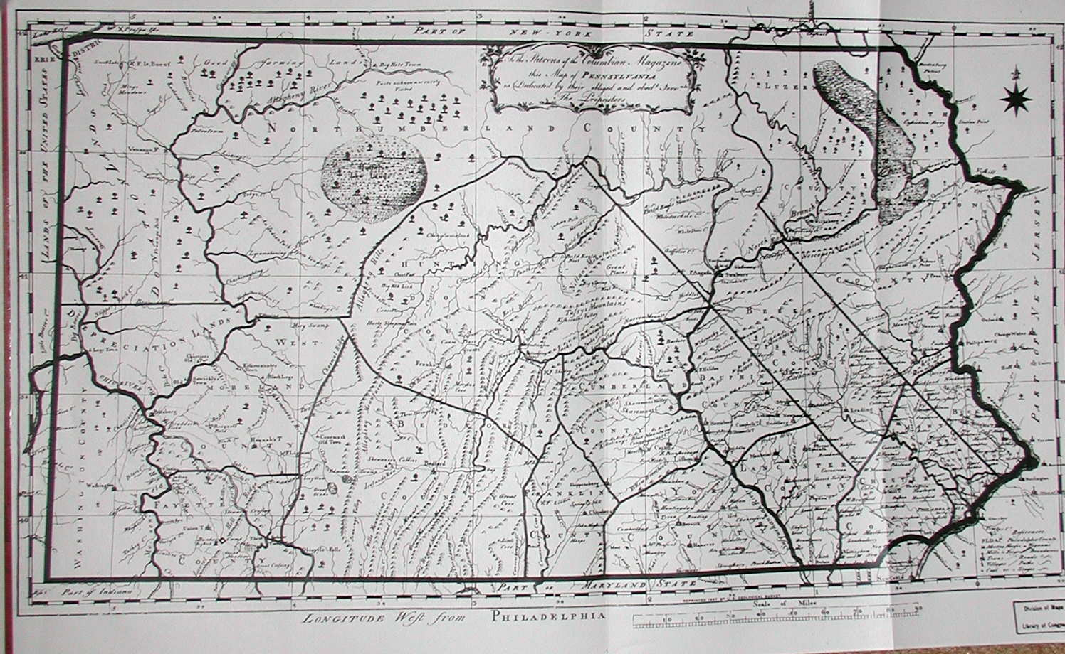
PA Formally Launches
Squatter region—Dutch, English, French, Welsh
Philadelphia
Penn
Purchases land from Natives
Fair treatment of Natives
Pennsylvania open to all
Drawback--
Anti-Natives Move In—Conflicts With Natives

Slide 24
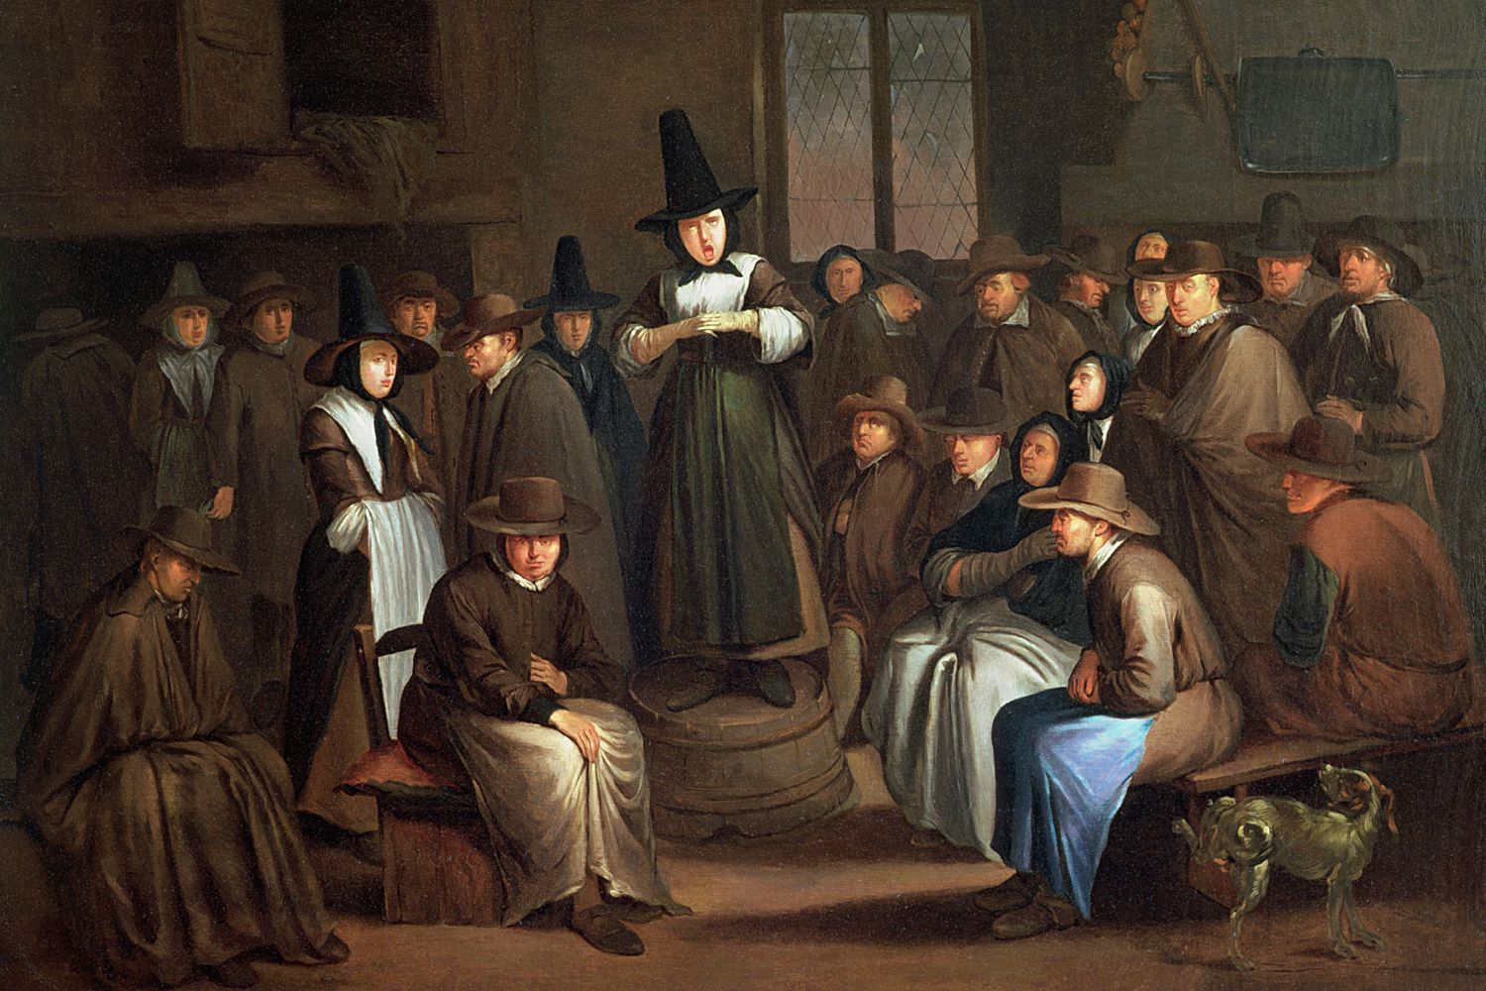
Set-Up of Pennsylvania
Representative Assembly (land owners)
No tax-supported church
Free worship
Catholics and Jews cannot vote—English influence
Limited death penalty
No immigration restrictions
Anti-slavery
Blue Laws
No dancing, singing cards, dice, games
Blue Laws—so named because of the paper they were written on
Also called “Sunday Laws”
Source of Income: Grains
Within three years—2,500 people live in PA

Slide 25
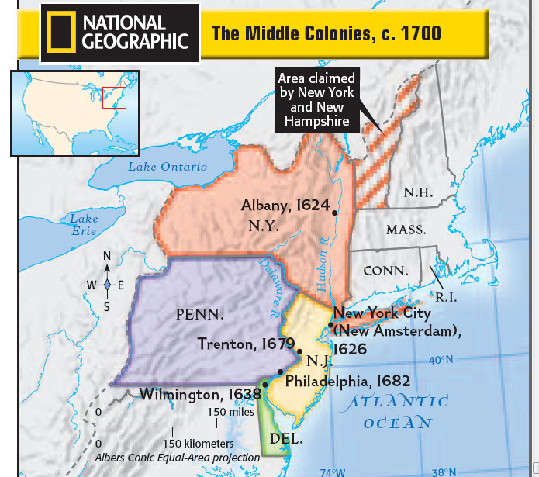
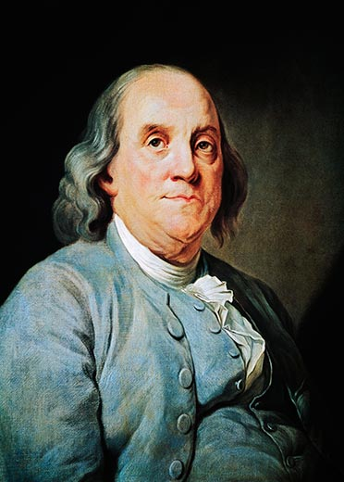
The Middle Colonies
NY, NJ, DE, PA form
Bread Colonies
Reliant on rivers
Economy: lumber, shipbuilding
Between New England and Plantations
More industry than S; More farming than N
Ethnically mixed; religious toleration
More unrest in England (Church and Government)
England gets more “hands off” with Colonies
Colonies continue to grow, especially in transportation
1720: Enter one of America’s Founding Fathers…

Slide 26
The Goal is Zero!
Spanish Armada
Mayflower Compact
Nina, Pina, Santa Maria
Pequot War
House of Burgesses
Fundamental Orders of Connecticut
Jamestown
Pueblo Revolt
King Philip’s War (Metacom’s War)
Glorious Revolution

Slide 27
The Goal is Zero!
1588
1620
1492
1636
1642
1639
1607
1680
1675
1688

